Slide 2
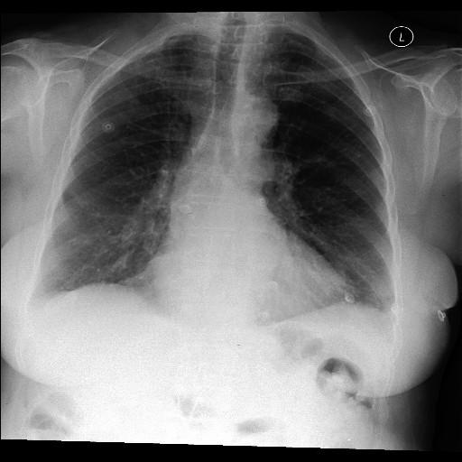
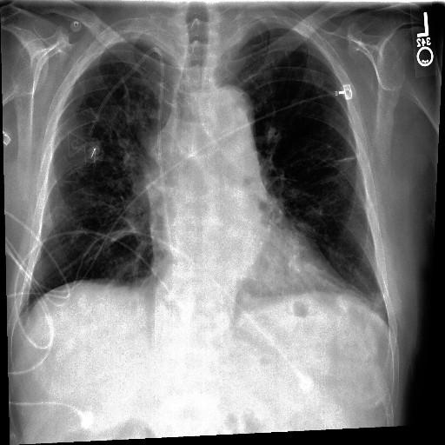
Atelectasis and no Pneumonia
good
Query: Atelectasis and no Pneumonia
Atelectasis and Pneumonia
returned

